Slide 1
UNIT-IV:
HUMAN VALUES AND
RELATIONSHIP MANAGEMENT
Human values- its significance, Social values, Integrity, Empathy, Character, Spirituality.
Relationship values-honesty, commitment, and compromise.
Building effective relations with peers and yourself.
Building effective relations with parents and elders.
Aspirations and parents’ expectations.

Slide 2

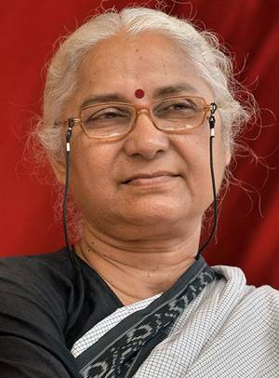
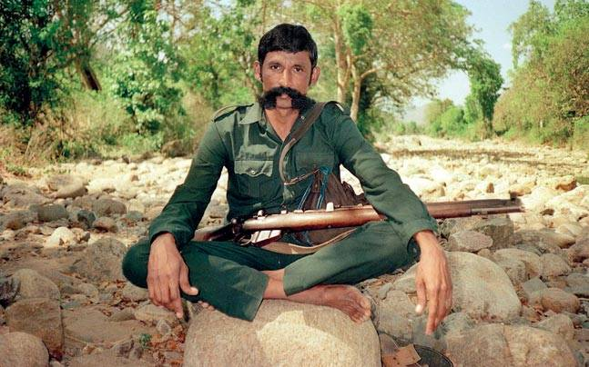
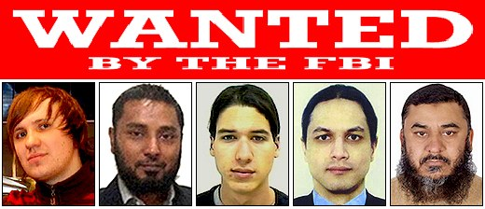

Slide 3
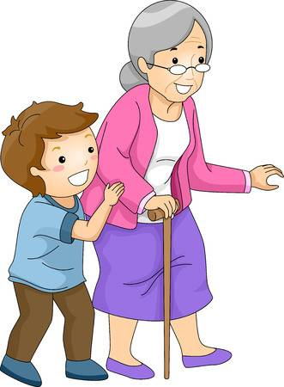
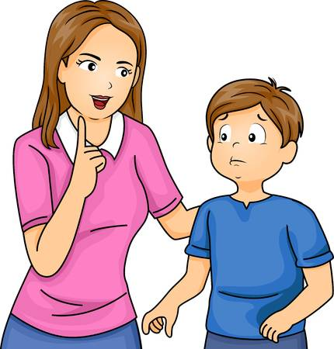

Slide 4

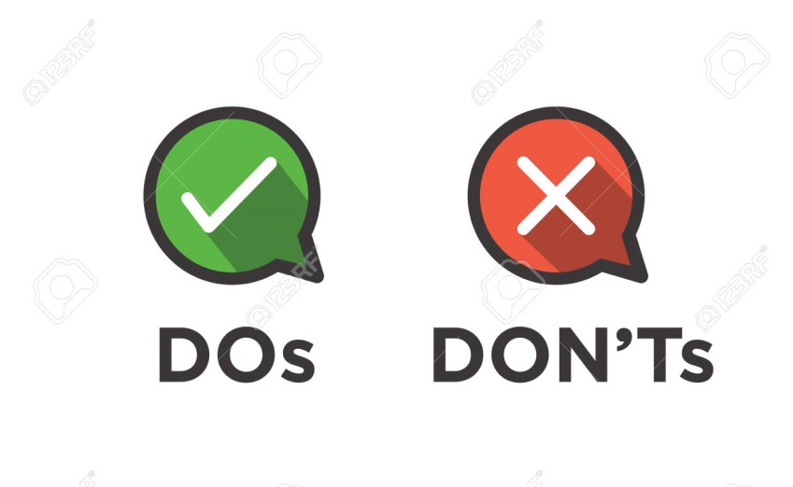


Slide 5

Meaning of Value:
The origin of the term ‘VALUE’, it may be stated very firmly that the term ‘VALUE’ comes from the Latin word ‘VALERE’ which means ‘to be of worth’.
Values are perception of good or bad, right or wrong.
Oxford Dictionary defines the term VALUE’ as the ‘worth, desirability or utility of a thing’.

Slide 6
SIGNIFICANCE OF VALUES
1. Values play an important role in the integration and fulfillment of man’s basic impulses and desires stably and consistently appropriate for his living.
2. They build up societies, integrate social relations.
3. They mold the ideal dimensions of personality and range and depth of culture.
4. They influence people’s behavior and serve as criteria for evaluating the actions of others.
5. They have a great role to play in the conduct of social life.
6. They help in creating norms to guide day-to-day behavior.

Slide 7
SOCIAL VALUES: HOW DIFFERENT ARE THEY FROM HUMAN VALUES.
HUMAN VALUES v/s SOCIAL VALUES
Human values are considered the first type of values as they have universal applicability.
Social values are the second type pertaining to one’s cultural context and society the person belongs to.
Examples of the first type which are the means of living include such values as honesty, integrity, etc. Examples of the second type, which are the ends of living, include such values as status, health, power and influence, and cultural beliefs.
Social values are a set of moral principles defined by society dynamics, institutions, traditions and cultural beliefs.
These values are implicit guidelines that provide orientation to individuals to conduct themselves properly within a social system.

Slide 8
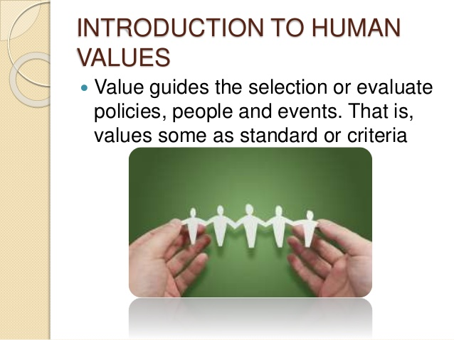

Slide 9
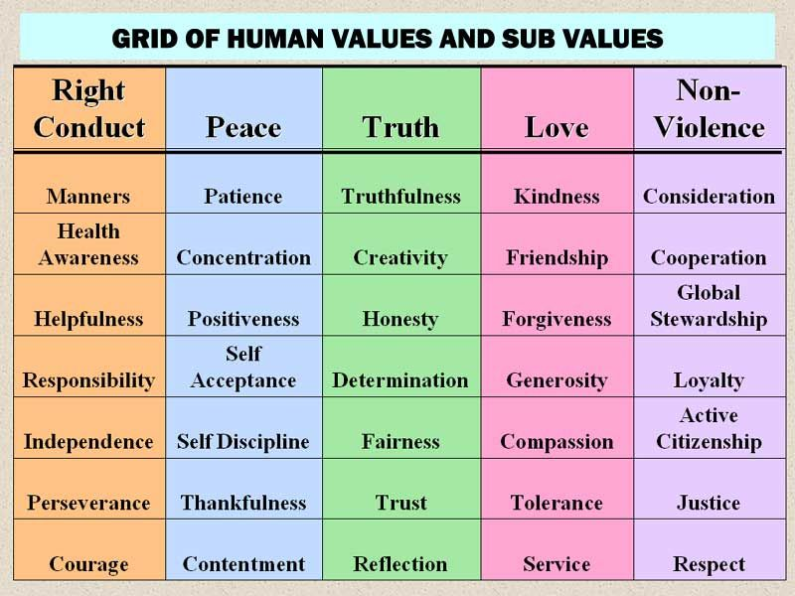
WHAT ARE HUMAN VALUES?
Human values are the virtues that guide us to take into account the human element when we interact with other human beings.
Notes:
Perseverance-continued effort and determination, stewardship-the job of supervising

Slide 10
WHY ARE HUMAN VALUES DETERIORATING?
Human values are deteriorating because we, humans have forgotten the essence of life.
Why do we use the term ‘Values’ with humans, not with animals?
The answer is these values make humans superior to other animals. But the irony is that we think that the vitality of life is to acquire more and more materialistic things.
We often come across the news like someone killed a person for some meager amount. Such incidents occur on account of our lack of comprehension of the ultimate goal of life.

Slide 11
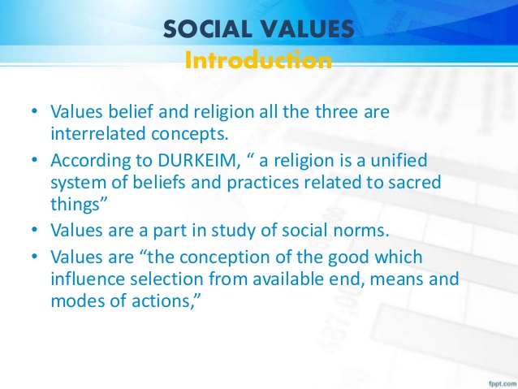
SOCIAL VALUES: Highest love for the people. The social man prizes other persons as ends and is, therefore, himself kind, sympathetic and unselfish.

Slide 12
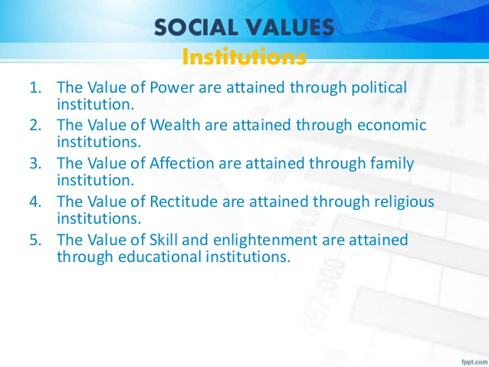

Slide 13
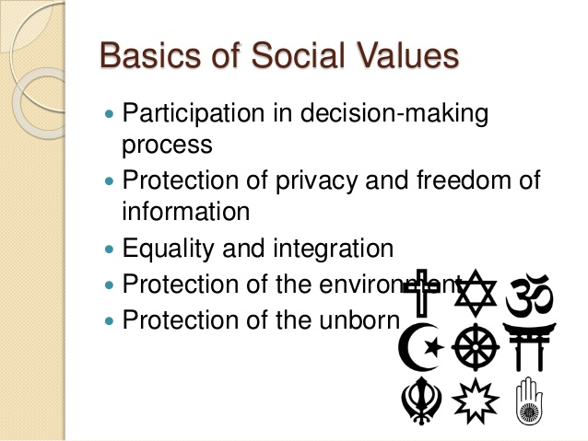

Slide 14
INTEGRITY

Slide 15
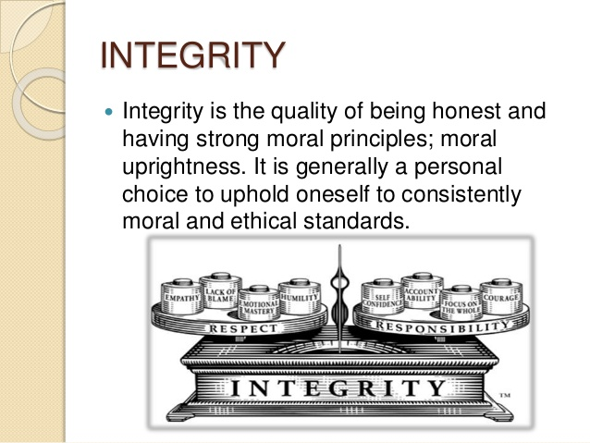

Slide 16
INTEGRITY:
Integrity demands a clear cut distinction between right and wrong with no grey areas in between.
Practicing integrity takes courage.
It is more associated with one’s character.
The way a man goes about fulfilling his duties and tasks is a showcase of his integrity.
It is the practice of a set of values that makes up a person’s integrity. Trust in many ways is a much greater compliment than love.
There are often people whom we love but cannot trust.
It is earned & inculcated through honesty & integrity.
Integrity means following moral or ethical convictions and doing the right thing in all circumstances, even if no one is watching.
Having integrity means being true to oneself and keeping away from actions that demeanor dishonors oneself.

Slide 17
What does it mean to have high integrity?
Having integrity means doing the right thing in a reliable way.
It's a personality trait that we admire since it means a person has a moral compass that doesn't waver.
It literally means having "wholeness" of character, just as an integer is a "whole number" with no fractions.

Slide 18
How do you demonstrate integrity?
Keep your word. If you want to establish a solid reputation you must deliver on your promises.
Keep your commitments towards work and tasks assignment.
Pay attention to your environment.
Stay focused on achieving your goal and aims.
Surround yourself with honest people for a man is known by the company he keeps.
Take responsibility and be proactive, do not wait to be told to do something when there is something going against values or fellow human beings.
Respect your peers and elders.

Slide 19
EMPATHY

Slide 20
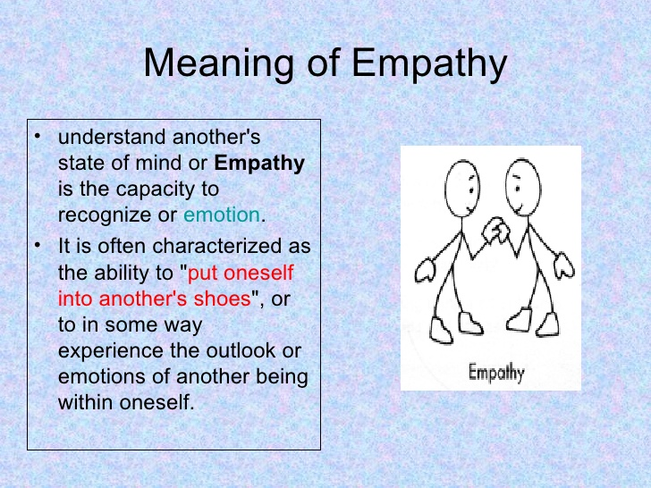

Slide 21
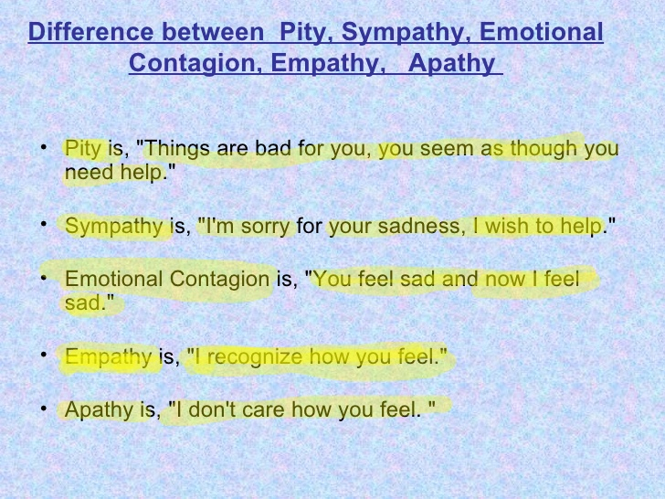

Slide 22
How does empathy help us?
you can understand what a person is feeling in a given moment, and understand why other people's actions made sense to them.
Empathy helps us to communicate our ideas in a way that makes sense to others.
It helps us understand others when they communicate with us.

Slide 23
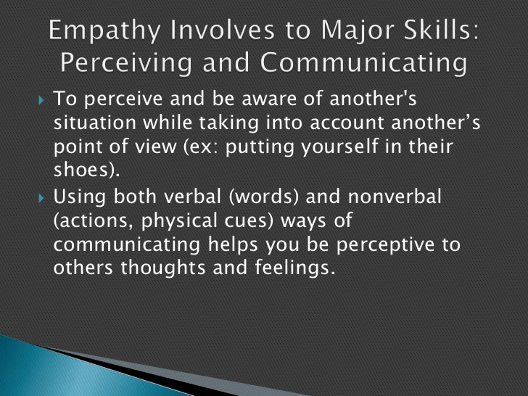

Slide 24
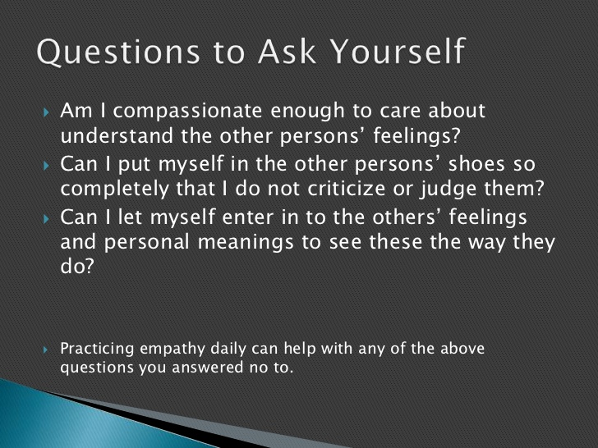

Slide 25
What are empathy skills?
Empathy is a critical skill for leaders too. In empathy, people feel what we believe are the emotions of another, which makes it both emotive and rational.
In this sense, arousal of empathy promotes pro-social behavior as we accommodate each other to feel similar emotions.
Empathy is, among other things, believed to improve our personal relationships, motivate charitable giving and encourage pro-social behaviors.
The general consensus is that empathy is crucial to being a good person.
Managing one’s emotions and seeking solutions to problems /situations is key to a person’s nature.

Slide 26
4. CHARACTER
Character is a composite of qualities that refer to values.
It is most importantly about honesty, ethics, consistency, loyalty, respect, openness, mental toughness & other positive qualities.
There are many human values that can be reflected in human character but the most relevant are listed as Integrity and Empathy which are external traits and Spirituality which are to develop the inner self and imbibe good values.

Slide 27
5. SPIRITUALITY
Meaning: A search for meaning in life.
It is a universal human experience something that touches us all.
Being a spiritual person is synonymous with being a person whose highest priority is to be loving to ourselves and others.
A spiritual person cares about people, animals, and the planet.
A spiritual person knows that all are one, and consciously attempts to honor this Oneness.
A spiritual person is a kind person.

Slide 28
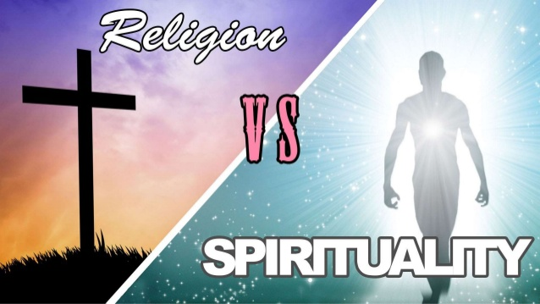

Slide 29
THE DIFFERENCE BETWEEN SPIRITUALITY AND RELIGION?
Meaning: Religion is a set of texts, practices, and beliefs shared by a community that practices or follows a particular religion, and involves a relationship with God.
Meaning: Spirituality is a person's relationship with the questions/situations that challenge one as a human being.
This may or may not involve relationships with God.
Spirituality has often become associated with the interior life of the individual, placing an emphasis upon the well-being of the "mind-body-spirit".
A spiritual practice or spiritual discipline (often including spiritual exercises) is the regular or full-time performance of actions and activities undertaken for the purpose of inducing spiritual experiences and cultivating spiritual development which in turn enables a person to achieve better goals for his and the wellbeing of others.

Slide 30
Religion is external behavior that is rule based, and that spirituality is more of an internalized behavior.
Spirituality as a smaller part of the larger construct of religion.
Religion without Spirituality causes terrorism, prejudice, extremism, Racism etc.
Spirituality without Religion is like if you decide to travel to another city without taking any known road.

Slide 31
?

Slide 32
RELATIONSHIP MANAGEMENT
Relationship values- honesty, commitment, and compromise.
Trust, teamwork, communication, and respect are the keys to effective working relationships.
Developing positive relationships with the individuals one interacts with makes life and work more enjoyable and productive.
Strong relationships take time to mature, so the focus should be on being consistent and dependable.

Slide 33
Are you really HONEST person?

Slide 34
HONESTY
Much has been said and written about honesty, and it is one of the most important values in a relationship. It is a base on which all other values stand. It is about being open about one’s deviations and mistakes and acknowledging them. The key is to not hide matters.

Slide 35
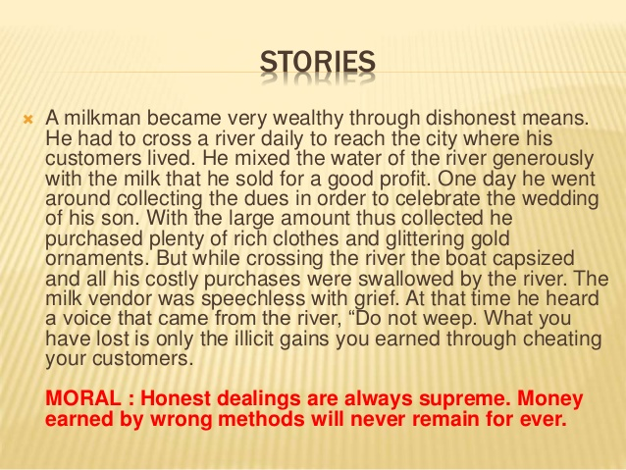

Slide 36
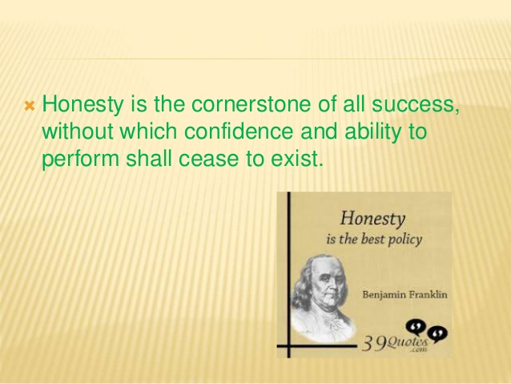

Slide 37


Slide 38
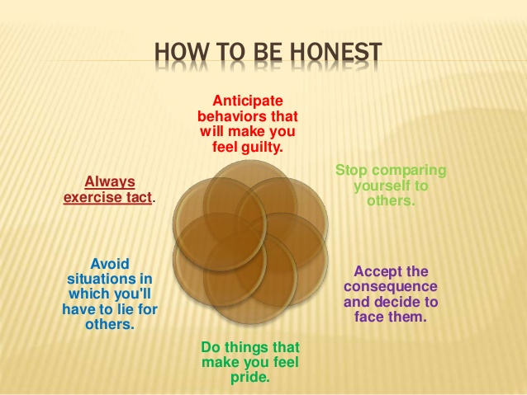

Slide 39
EQUALITY
Relationships sour when one does not treat others equally.
Unless and until you don't start thinking of others as equals to you in all aspects, you will have problems dealing with individuals.
Sharing every responsibility equally is the foremost commandment of every relationship.

Slide 40
EQUALITY AND RELATIONSHIPS
Healthy relationships are based on Equality (balance of power and control) People believe both are equal, neither tries to gain power or control, results in a non-violent and healthy relationship Communication and Compromise.
Non-threatening Behavior Talking and acting so both partners feel comfortable expressing their opinions/decisions Both feel safe around each other ◦(Not exhibiting Physical/Emotional abuse).
Connections w/Others Maintain friendships and family relationships with others Enjoy activities outside the relationship with other people Make own decisions about where they go, what they do, who they hang out with.

Slide 41
COMMITMENT
Making a commitment involves dedicating yourself to something, like a person or a cause.
A commitment obligates you to do something.
Some commitments are large and serious like marriage and some are normal and lighter like general friendships and membership to particular associations.
A committed relationship is an interpersonal relationship based upon mutually agreed-upon issues and word to one another involving love, trust, honesty, openness, or some other behavior.
Forms of committed relationships include close friendship, long-term relationships, engagement, marriage, and civil unions.

Slide 42
RESPECT
If you don't respect a person, then you wouldn't notice his good qualities. Respect is one of the most important values in a healthy relationship in that regard. It is such a value in life, which only increases when you give it to others. You simply cannot expect anyone to respect you or your point of view if you would not do the same to them. Respect should be earned not demanded.

Slide 43
UNDERSTANDING
Understanding is the second most important value in life. To cite a common example, many a time, a person knowingly commits a mistake. This could be because he does not have any other choice and has a good reason for committing that mistake. Yet, he comes and confesses to it. One should try to understand his mistake and the reason for which he committed it. Holding a grudge permanently is not only going to cause anguish to the person holding it, but also to the other person towards whom it is directed as well. Understanding and letting go is the mantra for having a peaceful mind.

Slide 44
DISCIPLINE
Everyone has many duties in life which they have to shoulder.
You have duties towards your parents, as they have brought you up.
You have duties towards your siblings, as you grew up with them.
You have duties towards your employers, as they are responsible for your livelihood.
The only way to shoulder these responsibilities is to be disciplined in your effort.
It is a common notion that being disciplined is just doing your work well.
It is going beyond just that and following the ideal rules of conduct.
Time management is an important feature of discipline

Slide 45
COMPROMISE
Compromise is commonly understood as giving up something in order to reach a place of understanding with a spouse, business partner or any other associate with whom you are associated with in life.
No two people are the same and due to different upbringings and beliefs, there is bound to be a clash of opinion or interest.
At some point in a relationship, people will have a different approach.
It is important to balance each other's needs by considering all options, which leads to mutual understanding between two individuals or team and work out a solution to resolve issues. Important to note that one should not compromise when it comes to legal, ethical or moral considerations.

Slide 46
?

Slide 47
BUILDING EFFECTIVE RELATIONS WITH PEERS AND YOURSELF
PEER PRESSURE:
Peer Pressure is a feeling that one must do the same things as other people of one's age and social group in order to be liked or respected by them. Peer pressure (or social pressure) is the direct influence on people by peers, or the effect on an individual who gets encouraged to follow their peers by changing their attitudes, values or behaviors to conform to those of the influencing group or individual.
Some of the main causes of peer pressure are related to age-appropriate behavior.
Adolescents develop a strong desire to fit in with their peers and be accepted by them. ...
Peer pressure occurs when a group of people coerces each other to go along with certain beliefs or behaviors.

Slide 48
Peer pressure can be POSITIVE or NEGATIVE.
When peer pressure is positive, it pushes you to be your best.
Negative peer pressure is when someone who is a friend or part of a group you belong to makes you feel that you have to do something to be accepted.
It’s the negative peer pressure that we usually think of when the phrase peer pressure is used. When you give in to negative peer pressure, you often feel guilty or disappointed with yourself for acting in a way that goes against your beliefs or values.

Slide 49
SOME EXAMPLES OF NEGATIVE PEER PRESSURE
Cheating or copying someone else’s work or letting others copy your work.
Not including certain people in social activities.
Taking dangerous risks when driving.
Using drugs or alcohol.
Shoplifting or stealing.
Engaging in sexual activity.
Engaging in bullying or cyber bullying.
Projecting a misleading/false image on social media.

Slide 50
WHAT STRATEGIES CAN HELP HANDLE NEGATIVE PEER PRESSURE?
1. Pay attention to how you feel. If something doesn’t feel right about a situation, it probably isn’t. Even if your friends seem ok with what is going on, the situation may not be right for you.
2. Plan ahead. Think about how you will respond in different situations. Plan what you can say or what you can do.
3. Talk to the person who is pressuring, let him or her know how it makes you feel and tell the person to stop.
4. Have a secret code to communicate with parents. Something you can say or text to your parent(s) that lets them know you need out of a situation. Parents can either call or text to say that you need to come home, or that they need to pick you up.

Slide 51
5. Give an excuse. It should be ok to say “no” without needing to apologize or give an explanation. But it may make it easier to say no if you have a ready reason. Perhaps saying you have a medical reason such as asthma or allergies that make it dangerous for you to take anything. Or even stating that your parents need you to come home if you feel it would be best to leave the situation altogether.
6. Have friends with similar values and beliefs. It is easier to say “no” if someone else is also saying it. Saying “no” together makes it easier for both of you.
7. Get support from a trusted adult such as a parent, teacher, or school counselor. A trusted adult can listen to you and help you with strategies that might work in your situation.

Slide 52
BUILDING EFFECTIVE RELATIONS WITH PARENTS AND ELDERS:
What is a parental relationship?
The parent-child relationship consists of a combination of behaviors, feelings, and expectations that are unique to a particular parent and a particular child. The relationship involves the full extent of a child's development.
Parents play the biggest role in mental, physical, social, financial and even career development.
The term parent-child relationship refers to the unique and enduring bond between a caregiver and his or her child. To understand the parent-child relationship, we must look at the ways that parents and children interact with one another physically, emotionally, and socially.

Slide 53
Here are some ways that can help children respect parents and build better and healthy relationships.
Create positive thoughts about parents. Our emotions are affected by our thoughts. Therefore, to be more understanding, start by thinking positively about parents.
Understand parents’ background and their struggles.
It is good to be open-minded about the generation gap between children and parents. Parents are also guided by their own experiences when dealing with children.
Communication can help understand the thoughts of parents. It will also strengthen the relationship as a family. Constant communication with parents is the key.
Express gratitude. Thanking parents for their sacrifices and everything they do is a very positive way of maintaining good relations.
Obey rules laid out by parents especially about time and other restrictions.

Slide 54
Be careful about the kind of language used while interacting with parents. Avoid saying foul words and being courteous is good. When they are talking, be polite by not butting in even if you disagree with what they say. Let them finish first.
Respect their decisions. There could be some decisions parents make that you do not agree with, express the same and work out a win-win situation.
Prioritize them over friends and boyfriend/girlfriend. Always put your family, especially your parents, above other people. Friends may come and go, but your family is forever.
Do not talk back, it is okay to reason out to parents to understand children’s’ side. However, this must be done in a gentle and respectful manner—by not arguing with them and imposing your views. Parents do have the last word.

Slide 55
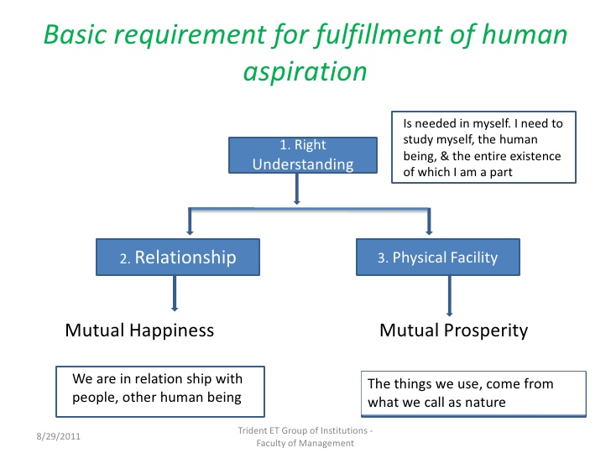
ASPIRATIONS AND PARENTS’ EXPECTATIONS:
A strong desire, longing, or aim; ambition: intellectual aspirations. a goal or objective that is strongly desired: The presidency has been his aspiration since boyhood. the act of aspirating or breathing in

Slide 56
MANAGING PARENTS’ EXPECTATIONS
What are the expectations? What does managing expectations mean?
Definition of expectation:
“strong belief that something will happen.” - Means you're trying to predict the future.
“A belief that someone will or should achieve something.”
Importance of Expectation:
Expectations are important as it helps one to focus on what one has to achieve.
On the flip side is if the expectations are unreasonable it will lead to tension and strain relationships giving scope for all the bitterness and negativity.
It is advised to keep communication open so that all involved have a clear understanding of what to expect and when to expect it.
Managing expectations means working towards what one is expected to do or should have to do for the sake of parents, guardians or any other person/organization that is close to you or benefits you.

Slide 57
WHY DO PARENTS HAVE EXPECTATIONS?
Parents want their children to be independent people who in the future can lead a meaningful life on their own.
Hence they coerce their children with expectations so that the child achieves them, becomes successful and has a safe life.
Parents also expect respect from their children and want them to be good citizens of the future.
Sometimes parents expect too much, which is termed as high expectations parents because of their own anxiety or fear. Love for the children and want the best for them, make parents worry a lot.
The child in such situations becomes a victim of parents’ expectations. Studies have shown that high parental expectations are more to do with high academic achievement.
Although setting expectations too high is common and is counterproductive, new research shows that with good communication and understanding between the parents and children, expectations can be set accordingly.
Social etiquette and behaviour are the most important expectations that the child has to meet and is necessary.

Slide 58
HOW TO MANAGE PARENTS’ EXPECTATIONS
Give yourself time and set short term and long term plans to meet goals .
Adapt to changing expectations. Accept the challenges in a positive way.
Never resort to shortcuts or unreliable means to achieve whatever parents want you to achieve.
Communicate with your parents about your shortcomings or weakness in case you cannot meet their expectations.
Prepare for problems, talk to your elders or experts to solve issues related to the expectations and goals.
Don't let pessimistic and negative individuals discourage you or define how you work. Plan and execute your methods with assistance from your trusted ones and parents.
The most important step to getting rid of fear and anxiety to meet expectations is to treat yourself kindly and develop the quality of endurance.
Adjust the way you think and speak. Altering these will make your path easier.
Free yourself from procrastination (postponing work). Goals and expectations become easier when achieved on time.
Stop judging your parents and respect them. Try to meet their expectations with an unbiased mind.

Slide 59
?

